Slide 1


CC0003 Ethics and Civics in a Multicultural World
Week 10: Political Systems
Prof Walid Jumblatt Bin Abdullah

Slide 2
Learning Objectives
By the end of this lecture, you should be able to:
Explain the concept of democracy.
Explain democracy in Asia.

Slide 3
Outline
The following topics will be covered in this lecture:
Political Systems
Democracy
Asian Values
Conclusion

Slide 4
CC0003 Ethics and Civics in a Multicultural World
Week 10: Political Systems
Topic 01: Political Systems
Prof Walid Jumblatt Bin Abdullah

Slide 5
Political Systems
Democracy
A system where the individual is at the heart of the polity.
Individual freedoms and rights are protected.
Powers of the executive are constrained.
Autocracy
Powers of the executive are less constrained.
Decision-making powers are in the hands of fewer people than in a democracy.

Slide 6
Acknowledgements:
Slide 1 and 4: jenny on the moon. (n.d.). Young people putting paper ballots to election box. The public brings its decision to the voting box. Voting and election concept. Democratic election. Vector flat illustration. [Vector]. Adobe Stock Images. https://stock.adobe.com/sg/images/young-people-putting-paper-ballots-to-election-box-the-public-brings-its-decision-to-the-voting-box-voting-and-election-concept-democratic-election-vector-flat-illustration/375586849

Slide 7
CC0003 Ethics and Civics in a Multicultural World
Week 10: Political Systems
Topic 02: Democracy
Prof Walid Jumblatt Bin Abdullah

Slide 8
Democracy: History
Liberal Democracy
Existed in some form in Britain
Ideals from French Revolution
Liberty, Fraternity and Equality
Realised in the American Revolution (to some extent)
Standard which the world is judged by today
Due to Western hegemony

Slide 9
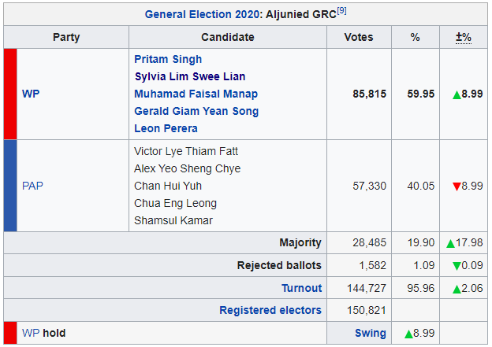
Democracy: Features
Here are some basic features of democracy:
Free and fair elections
Separation of powers
Individual freedoms
Freedom of speech
Freedom of assembly
Free press/ media
Fourth estate
Independent judiciary
Procedural + substantive aspects of a democracy
Elections maketh not a democracy

Slide 10
Democracy: The Case For It
Corruption Perceptions Index (2020)
1. Denmark
1. New Zealand
3. Finland
3. Singapore
3. Sweden
3. Switzerland
7. Norway
8. Netherlands
9. Luxembourg
9. Germany
GDP per capita (2019)
1. Luxembourg
2. Switzerland
3. Norway
4. Iceland
5. Ireland
6. Qatar
7. United States
8. Singapore
9. Denmark
10. Australia
Happiness Index (2019)
1. Finland
2. Denmark
3. Norway
4. Iceland
5. Netherlands
6. Switzerland
7. Sweden
8. New Zealand
9. Canada
10. Austria

Slide 11
Democracy: The Case For It
The four values of democracy by Amartya Sen:
Intrinsic Value
Personal freedoms and individual liberties are part of a person’s utility function.
Human beings innately desire to be free.
To be prevented from political participation in the political life of the community is a major deprivation.
It is better to die on your feet than to live on your knees.

Slide 12
Democracy: The Case For It
Happiness Index (2019)
1. Finland
2. Denmark
3. Norway
4. Iceland
5. Netherlands
6. Switzerland
7. Sweden
8. New Zealand
9. Canada
10. Austria

Slide 13
Democracy: The Case For It
Instrumental Value
Democracy helps to ensure good outcomes.
More transparency ensures less corruption.
More public accountability (through elections, a free media etc.) ensures government would act in the interests of the people.
More transparency and accountability means public funds are spent better; and foreign investors are more likely to fund domestic projects.
And therefore, higher economic growth!
No democracy has ever gone through a famine.
Countries which undergo democratisation become richer.

Slide 14
Democracy: The Case For It
GDP per capita (2019)
1. Luxembourg
2. Switzerland
3. Norway
4. Iceland
5. Ireland
6. Qatar
7. United States
8. Singapore
9. Denmark
10. Australia

Slide 15
Democracy: The Case For It
Constructive Value
Only in a democracy, can citizens learn from one another properly through dialogue and discussion.
More importantly, only in a democracy can a society decide what it ‘wants’ and ‘needs’.
In its absence, elites would decide for people.
Therefore, democracies allow societies to ‘construct’ their own preferences.

Slide 16
Democracy: The Case For It
Universal Value
Definition:
Not that everyone in the world agrees on it (otherwise, there would be no such thing).
Rather, it is something which people everywhere would have good reason to find valuable.
All cultures – including non-Western ones – have demonstrated commitment to keeping the power of rulers in check and respecting minority rights.
Examples:
Confucius saying ‘tell the ruler the truth even if it offends him.
Jewish scholar Maimonides ran away from an intolerant Europe to seek refuge in the Muslim world.

Slide 17
Democracy: The Other Side
However, the following questions must be considered:
Are all cultures equally predisposed to democracy?
Is democracy necessary, or even good, for economic growth at all stages of development?
Are all societies suited for democracy?
What about the societies who have suffered from ‘too much democracy’?

Slide 18
Acknowledgements:
Slide 7: jenny on the moon. (n.d.). Young people putting paper ballots to election box. The public brings its decision to the voting box. Voting and election concept. Democratic election. Vector flat illustration. [Vector]. Adobe Stock Images. https://stock.adobe.com/sg/images/young-people-putting-paper-ballots-to-election-box-the-public-brings-its-decision-to-the-voting-box-voting-and-election-concept-democratic-election-vector-flat-illustration/375586849
Slide 9: Aljunied Group Representation Constituency. (2021, July 18). In Wikipedia. https://en.wikipedia.org/wiki/Aljunied_Group_Representation_Constituency
Slide 10: Transparency International. (2019, January). Corruption Perceptions Index 2018. https://www.transparency.org/en/cpi/2020/index/nzl
Slide 10 and 12: Helliwell, J., Layard, R., & Sachs, J. (2019). World Happiness Report 2019, New York: Sustainable Development Solutions Network. https://worldhappiness.report/ed/2019/
Slide 10 and 14: List of countries by GDP (PPP) per capita. (2021, June 28). In Wikipedia. https://en.wikipedia.org/wiki/List_of_countries_by_GDP_(PPP)_per_capita

Slide 19
CC0003 Ethics and Civics in a Multicultural World
Week 10: Political Systems
Topic 03: Asian Values
Prof Walid Jumblatt Bin Abdullah

Slide 20
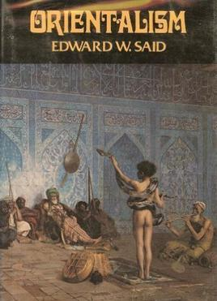
Asian Values: Creating the “Other”
In his book, Orientalism, Said explains that:
Europeans/ Americans viewed others in distorted ways.
They saw Europeans/ Anglo-Saxons as superior.
Non-Europeans were backwards, misogynistic, uncivilised, almost sub-human.
Therefore, non-whites needed to be ‘saved’.

Slide 21
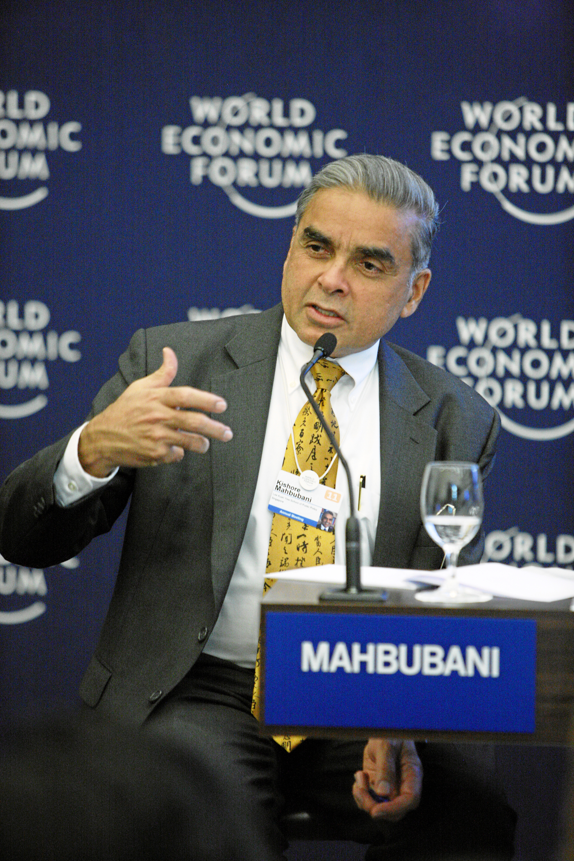
Asian Values: The Debate
According to Kishore Mahbubani, a Singaporean civil servant, a career diplomat and an academic, the Human Rights and Democracy Debate is just an extension of the Orientalist problem.
The West feels a need to ‘save’ the non-Western world from itself!
Authoritarianism is despotism.
Western democracy is universal, desirable, and implementable.
Sharp dichotomy

Slide 22
Asian Values: Lessons from Asia
According to Bilahari Kausikan, a Singaporean academic, and retired diplomat and civil servant:
What people want is good governance, not democracy per se!
Does not matter if it is a black or white cat, as long as the cat catches the rat.
According to Kishore Mahbubani:
West should not be concerned about exporting human rights but should care about uplifting standards of living.
An imperfect government that commits some Human Rights violations is better than no government!

Slide 23
Asian Values: Lessons from Asia
Corruption Perceptions Index (2018)
1. Denmark
2. New Zealand
3. Finland
3. Singapore
3. Sweden
3. Switzerland
7. Norway
8. Netherlands
9. Canada
9. Luxembourg
GDP per capita (2019)
1. Luxembourg
2. Switzerland
3. Norway
4. Iceland
5. Ireland
6. Qatar
7. United States
8. Singapore
9. Denmark
10. Australia

Slide 24
Asian Values: Lessons from Asia
“
“There are no short cuts: it is necessary for a developing society to first succeed in economic development before it can attain social and political freedoms.”
~ (Mahbubani, 2009)
“

Slide 25
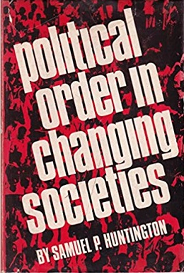
Asian Values: Lessons from Asia
“
“In developing countries, order is the most important thing!!”
~ (Huntington & Fukuyama, 1996)
Political order is necessary for development
No dignity in chaos or poverty
“

Slide 26
Asian Values: Lessons from Asia
“
“With few exceptions, democracy has not brought good government to new developing countries… What Asians value may not necessarily be what Americans or Europeans value. Westerners value the freedoms and liberties of the individual. As an Asian of Chinese cultural background, my values are for a government which is honest, effective and efficient.”
~ (Lee, 2000)
“

Slide 27
Asian Values: Lessons from Asia
“
“In China’s known 4000-year history, no government was elected by counting heads.”
~ (Lee, 2000)
“

Slide 28
Asian Values: Lessons from Asia
Asians value different things, such as:
Filial piety
Respect toward authority
Communitarianism
Community before self
Social harmony
Socio-economic prosperity
Consensus, not conflict
Therefore, liberal democracy may not be compatible with Asian societies.
Singapore’s
National Shared Values
Nation before community and society above self
Family as the basic unit of society
Community support and respect for the individual
Consensus, not conflict
Racial and religious harmony

Slide 29
Acknowledgements:
Slide 19: jenny on the moon. (n.d.). Young people putting paper ballots to election box. The public brings its decision to the voting box. Voting and election concept. Democratic election. Vector flat illustration. [Vector]. Adobe Stock Images. https://stock.adobe.com/sg/images/young-people-putting-paper-ballots-to-election-box-the-public-brings-its-decision-to-the-voting-box-voting-and-election-concept-democratic-election-vector-flat-illustration/375586849
Slide 20: Orientalism (book). (2021, July 15). In Wikipedia. https://en.wikipedia.org/wiki/Orientalism_(book)
Slide 21: Kishore Mahbubani. (2021, May 24). In Wikipedia. https://en.wikipedia.org/wiki/Kishore_Mahbubani
Slide 23: Transparency International. (2019, January). Corruption Perceptions Index 2018. https://www.transparency.org/en/cpi/2018/index/dnk#
Slide 23: List of countries by GDP (PPP) per capita. (2021, June 28). In Wikipedia. https://en.wikipedia.org/wiki/List_of_countries_by_GDP_(PPP)_per_capita
Slide 24: Mahbubani, K. (2009). Can Asians Think?. (4th ed., Vol. 4). Marshall Cavendish International. https://archive.org/details/CanAsiansThink/page/n90/mode/2up
Slide 25: Huntington, S., & Fukuyama, F. (1996). Political Order in Changing Societies. Yale University Press. http://www.jstor.org/stable/j.ctt1cc2m34
Slide 25: Political Order in Changing Societies. (2020, September 28). In Wikipedia. https://en.wikipedia.org/wiki/Political_Order_in_Changing_Societies
Slide 26 and 27: Lee, K.Y. (2000). From Third World to First, The Singapore Story: 1965–2000. Times Media.

Slide 30
CC0003 Ethics and Civics in a Multicultural World
Week 10: Political Systems
Topic 04: Conclusion
Prof Walid Jumblatt Bin Abdullah

Slide 31
Conclusion
The debate on democracy is extremely ideological and political. But also concerns issues such as justice and philosophical matters such as the trade-off between liberty and security.
For example, think of the Trace Together debate.
It is a debate which Singapore must contend with especially with the rise of calls for more democratisation.

Slide 32
Questions
Is liberal democracy universal?
Do Asians really value different things?
How do we prove this?
Do Western countries have credibility to export democracy and human rights?
Even if the messenger is flawed, does that mean the message should be ignored?

Slide 33
Acknowledgements:
Slide 30: jenny on the moon. (n.d.). Young people putting paper ballots to election box. The public brings its decision to the voting box. Voting and election concept. Democratic election. Vector flat illustration. [Vector]. Adobe Stock Images. https://stock.adobe.com/sg/images/young-people-putting-paper-ballots-to-election-box-the-public-brings-its-decision-to-the-voting-box-voting-and-election-concept-democratic-election-vector-flat-illustration/375586849

Slide 34
